Slide 1
Natural language understanding AT SCALE WITH SPACY AND SPARK NLP
Claudiu Branzan Alex Thomas David Talby

Slide 2
Natural language understanding at scale with spaCy & Spark NLP
Please setup your laptop for the tutorial:
1. Install Docker: https://docs.docker.com/engine/installation/
2. Pull the image: docker pull melcutz/nlu-demo
3. Run the image: docker run -it --rm -p 8888:8888 melcutz/nlu-demo

Slide 3
Our agenda in 5 notebooks
prologue: LANGUAGE UNDERSTANDING use cases
Introduction to spaCy
Named entity extraction & Word embeddings
ML & NLP: Building a document classifier
Introduction to Spark NLP
Embeddings, topics & model fitting with Spark NLP

Slide 4
The first rule of nlP is
We all speak many languages.

Slide 5

EMERGENCY ROOM LANGUAGE
Triage Notes
states started last night, upper abd, took alka seltzer approx 0500, no relief. nausea no vomiting
Since yeatreday 10/10 "constant Tylenol 1 hr ago. +nausea. diaphoretic. Mid abd radiates to back
Generalized abd radiating to lower x 3 days accompanied by dark stools. Now with bloody stool this am. Denies dizzy, sob, fatigue. Visiting from Japan on business.”
Features
Type of Pain Intensity of Pain Body part of region | Symptoms Onset of symptoms Attempted home remedy
Notes:
There is not one “language” – every vertical and communication channel has its own jargon that includes vocabulary, grammar, assumptions and semantics.
For example – in these ED triage notes, none of the sentences is in valid English, and the words “patient” and “pain” do not appear.

Slide 6
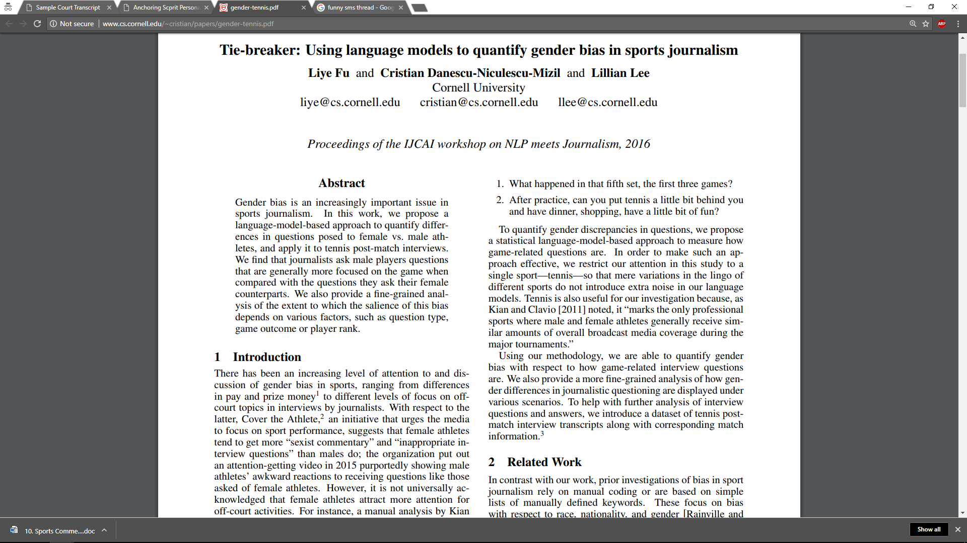
ACADEMIC LANGUAGE
Features
Summarize Main Result Theory or Experiment? Benchmark Used | Double Blind? Sample Size? All Results Published?
Title: Keyword Heavy, common word plays
Authors, affiliations & contact details
Abstract: Best Summary of Work & Results
Introduction, related work, experiment, …
Professional language, correct grammar
Notes:
There is not one “language” – every vertical and communication channel has its own jargon that includes vocabulary, grammar, assumptions and semantics.
For example – in these ED triage notes, none of the sentences is in valid English, and the words “patient” and “pain” do not appear.

Slide 7
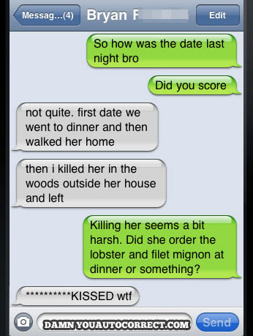
SMS LANGUAGE
Features
Who did What? When and Where? How do they feel about it?
Meaning split across many snippets
Most Snippets aren’t grammatically correct
Slang, profanity & inside jokes
Emojis for sentiment analysis
Auto-Correct Issues
Also a challenge with OCR & ASR
Notes:
There is not one “language” – every vertical and communication channel has its own jargon that includes vocabulary, grammar, assumptions and semantics.
For example – in these ED triage notes, none of the sentences is in valid English, and the words “patient” and “pain” do not appear.

Slide 8
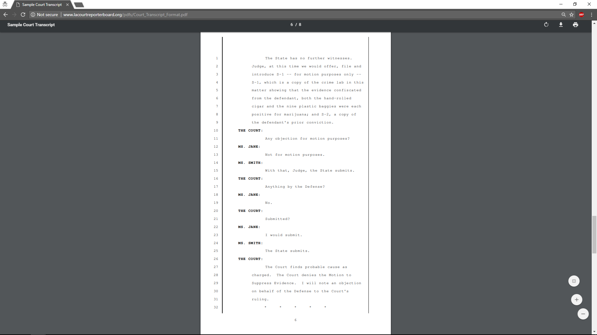
LEGAL TRANSCRIPTIONS LANGUAGE
Features
Kind of hearing Kind of motion Who filed it | Evidence presented Witnesses presented Decision
Verbatim conversation
Procedural step-by-step process
Jargon is specific to kind of procedure
Dashes indicate pauses or talkovers
Notes:
There is not one “language” – every vertical and communication channel has its own jargon that includes vocabulary, grammar, assumptions and semantics.
For example – in these ED triage notes, none of the sentences is in valid English, and the words “patient” and “pain” do not appear.

Slide 9
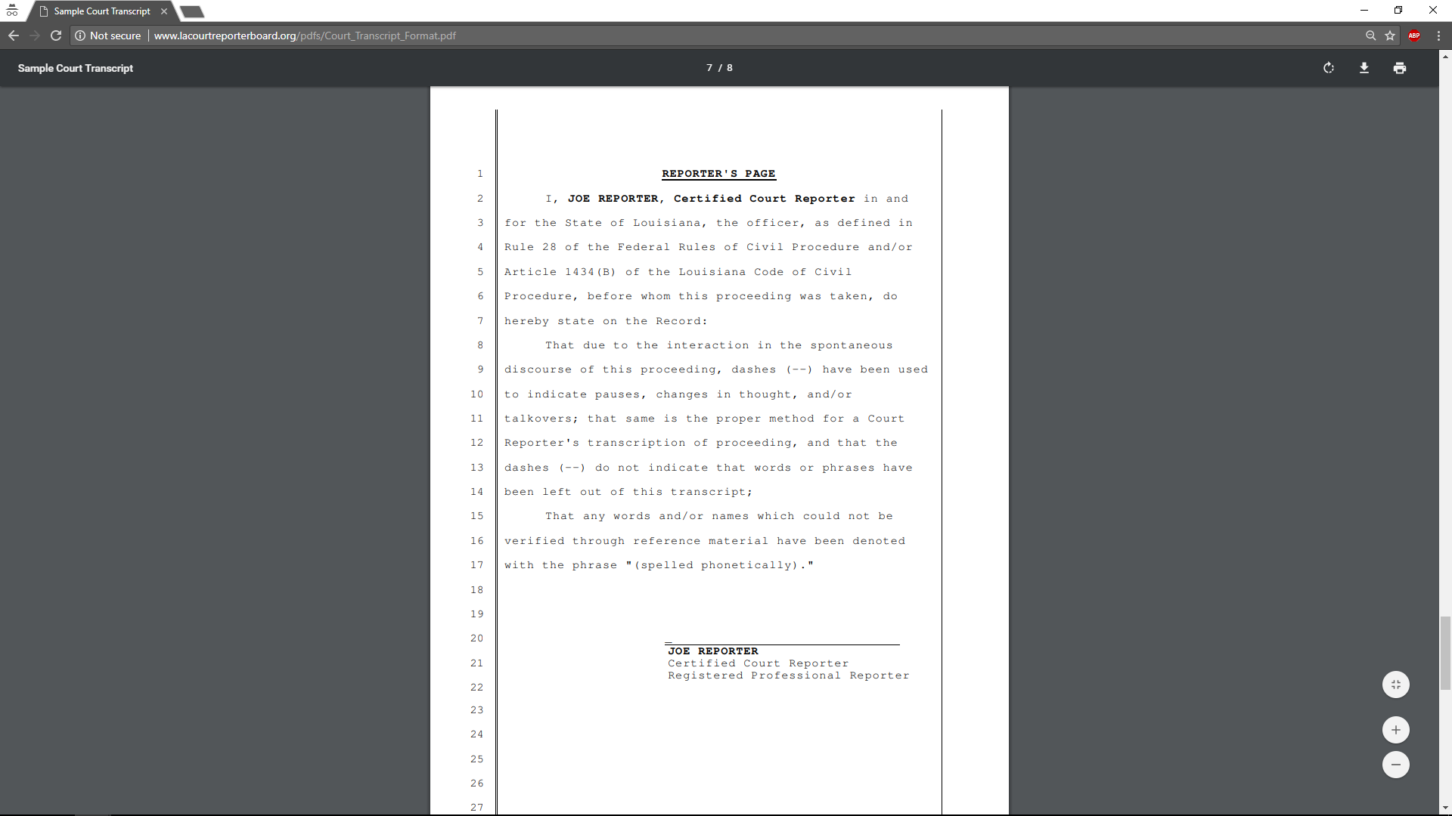
LEGAL LANGUAGE
Plus a lot of boilerplate text
This also applies to financial documents See: SEC Filings Tutorial by the National Center for Business Journalism
Notes:
There is not one “language” – every vertical and communication channel has its own jargon that includes vocabulary, grammar, assumptions and semantics.
For example – in these ED triage notes, none of the sentences is in valid English, and the words “patient” and “pain” do not appear.

Slide 10
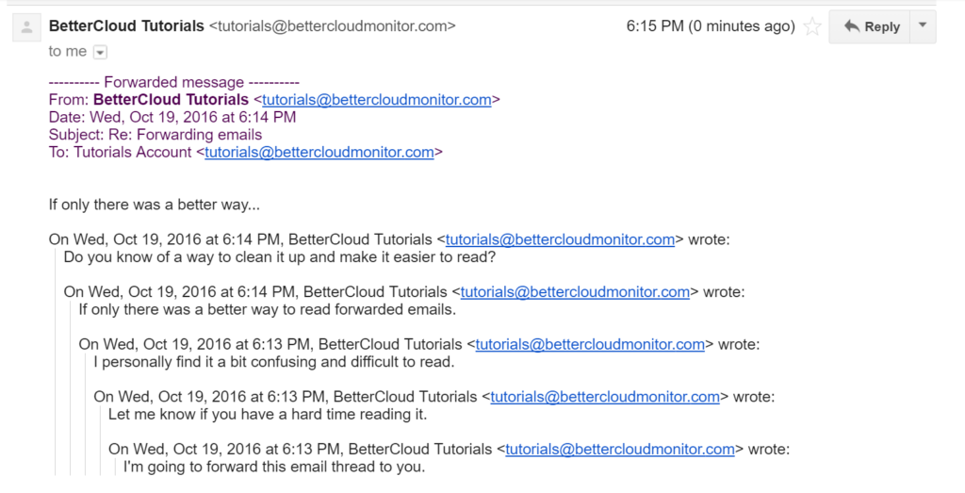
EMAIL LANGUAGE
Features
Schedule Meeting Assign a Task Approve or Deny a Request
Structured from, to, date, subject fields
Reply & Forward text in emails
Conversation: Timeline is important
Grammar of written language (not spoken)
Spam, promotions and calls to action
Notes:
There is not one “language” – every vertical and communication channel has its own jargon that includes vocabulary, grammar, assumptions and semantics.
For example – in these ED triage notes, none of the sentences is in valid English, and the words “patient” and “pain” do not appear.

Slide 11
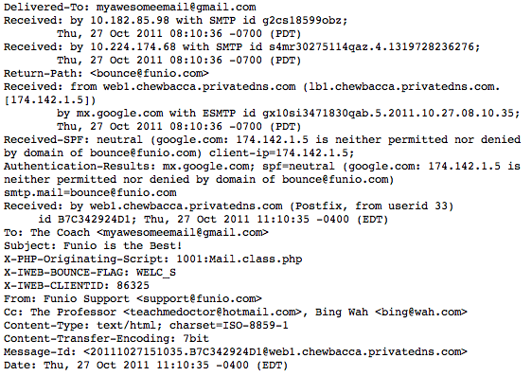
EMAIL LANGUAGE
That’s the string you actually get as input
Notes:
There is not one “language” – every vertical and communication channel has its own jargon that includes vocabulary, grammar, assumptions and semantics.
For example – in these ED triage notes, none of the sentences is in valid English, and the words “patient” and “pain” do not appear.

Slide 12
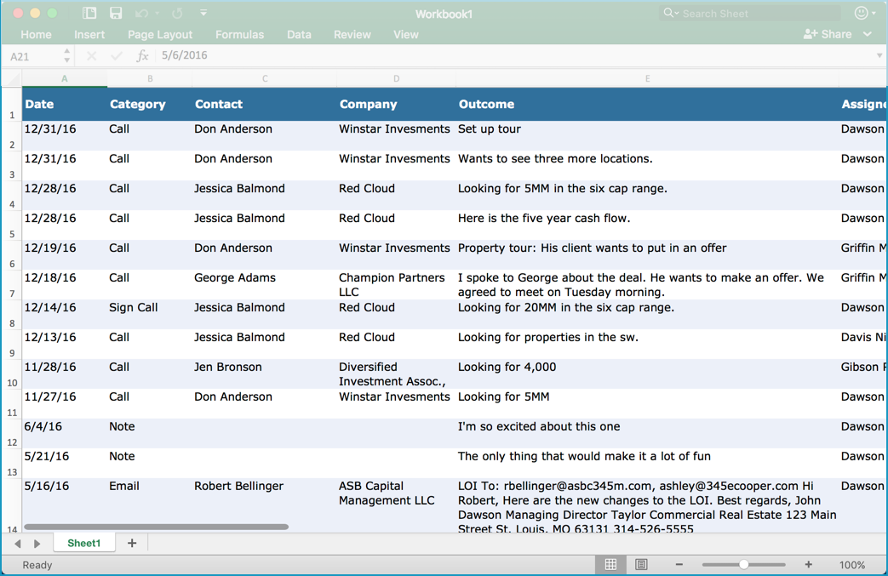
SALES (CRM) LANGUAGE
Features
Budget Authority Need Timeframe
Likelihood of a sale? Time to a sale? Need executive intervention?
Notes:
There is not one “language” – every vertical and communication channel has its own jargon that includes vocabulary, grammar, assumptions and semantics.
For example – in these ED triage notes, none of the sentences is in valid English, and the words “patient” and “pain” do not appear.

Slide 13
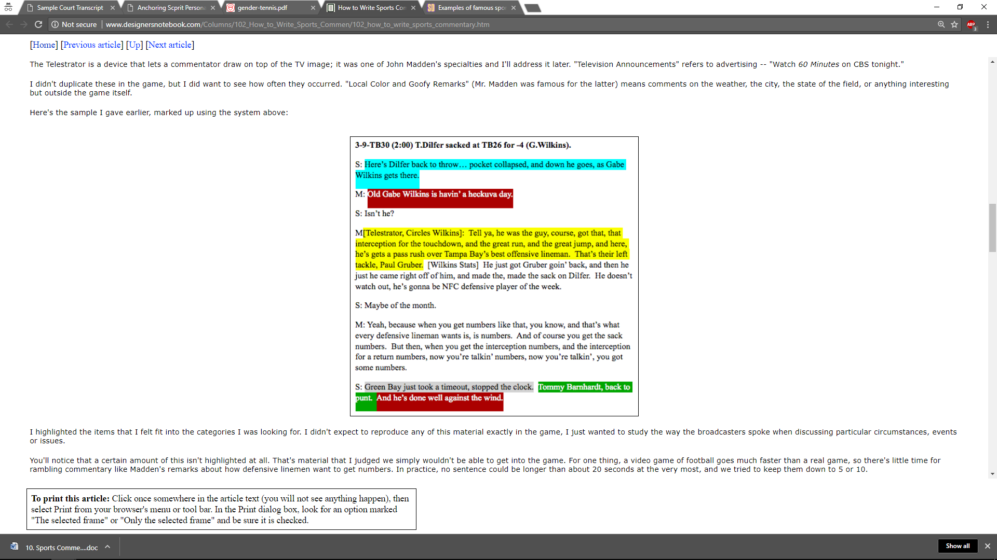
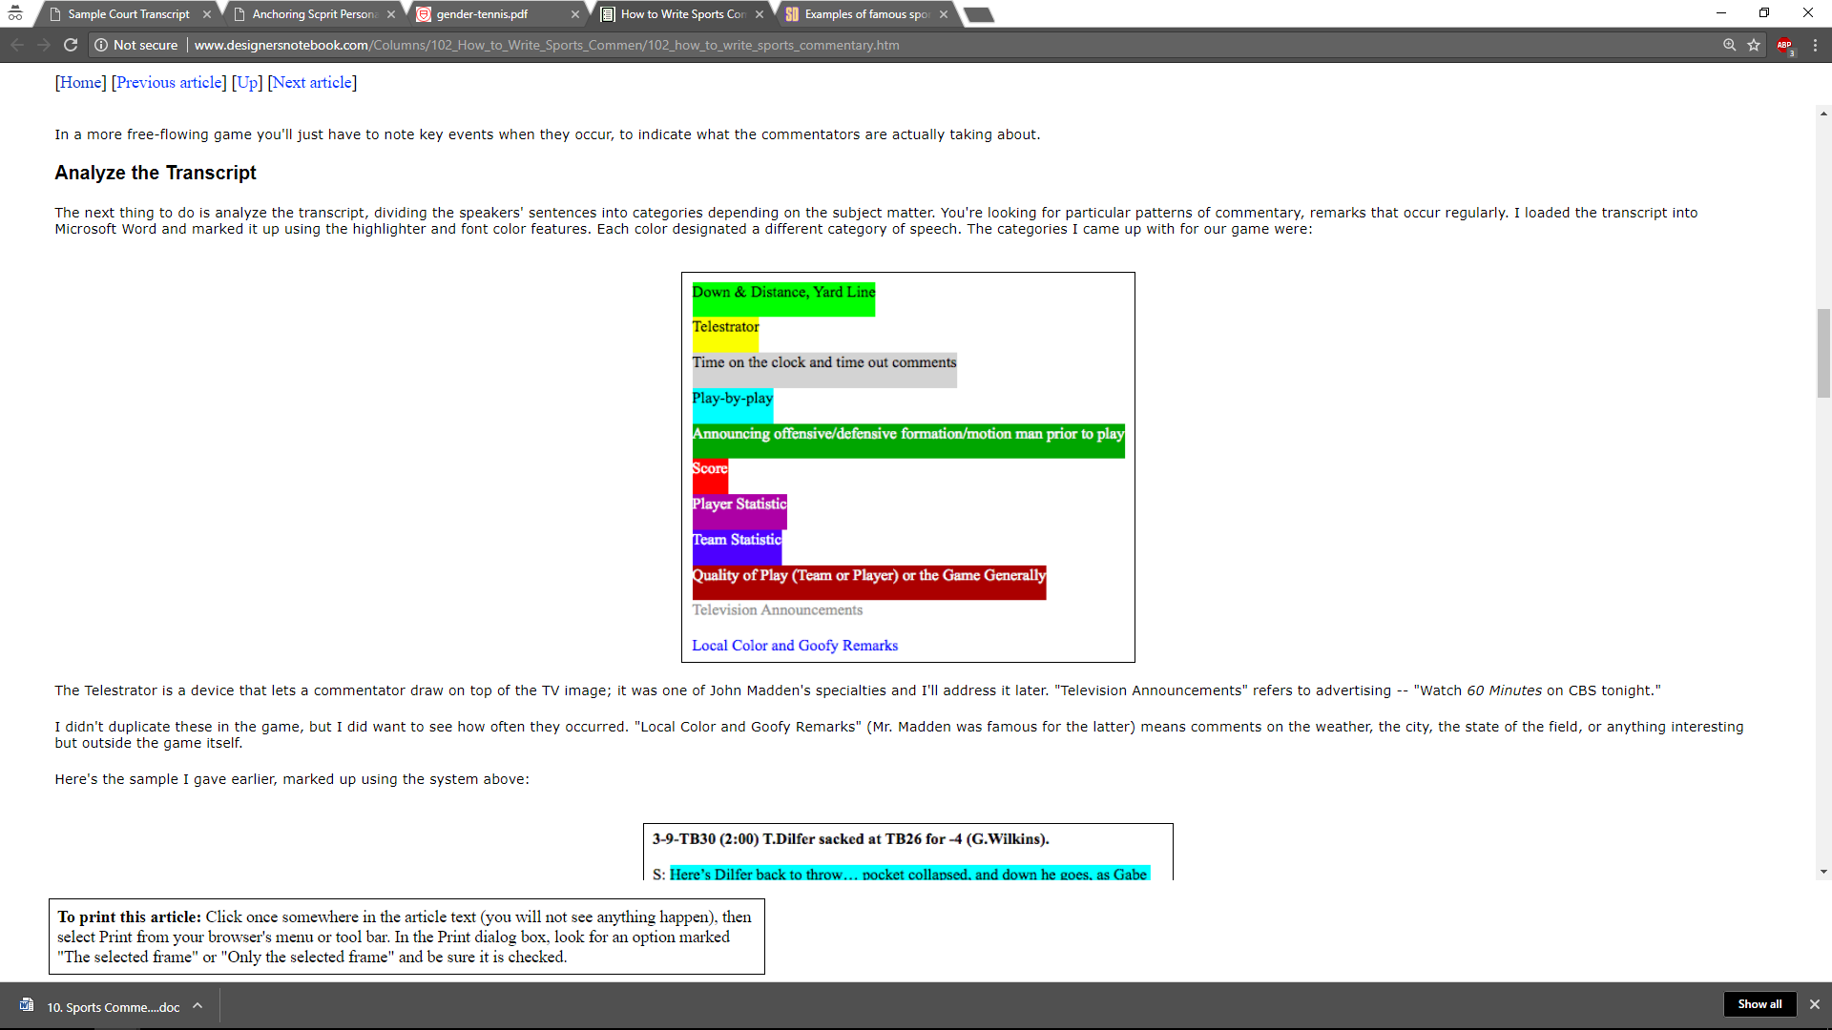
SPORTS (NFL) LANGUAGE
Notes:
There is not one “language” – every vertical and communication channel has its own jargon that includes vocabulary, grammar, assumptions and semantics.
For example – in these ED triage notes, none of the sentences is in valid English, and the words “patient” and “pain” do not appear.

Slide 14
Different Vocabulary
Tokenizer Normalizer
Lemmatizer Fact Extraction
Part of Speech Tagger Spell Checker
Coreference Resolution Dependency Parser
Sentence Splitting Negation Detection
Different Grammar
Different Context
Named Entity Recognition Sentiment Analysis
Intent Classification Summarization
Word Embeddings Emotion Detection
Different Meaning
Question Answering Relevance Ranking
Best Next Action Translation
Different Language Models

Slide 15
Our agenda in 5 notebooks
prologue: LANGUAGE UNDERSTANDING use cases
Introduction to spaCy
Named entity extraction & Word embeddings
ML & NLP: Building a document classifier
Introduction to Spark NLP
Embeddings, topics & model fitting with Spark NLP

Slide 16
NLP libraries
By Ecosystem:
Python: NLTK, spaCy, gensim
JVM: OpenNLP, CoreNLP, Spark NLP, UIMA, GATE, Mallet
Others: tm for R, SAS, Watson, Matlab, …
By Design:
Raw functionality: NLTK, OpenNLP
Annotation libraries: spaCy, Spark NLP, UMIA, GATE
Industrial Grade, Open Source, Supported:
spaCy
Spark NLP

Slide 17
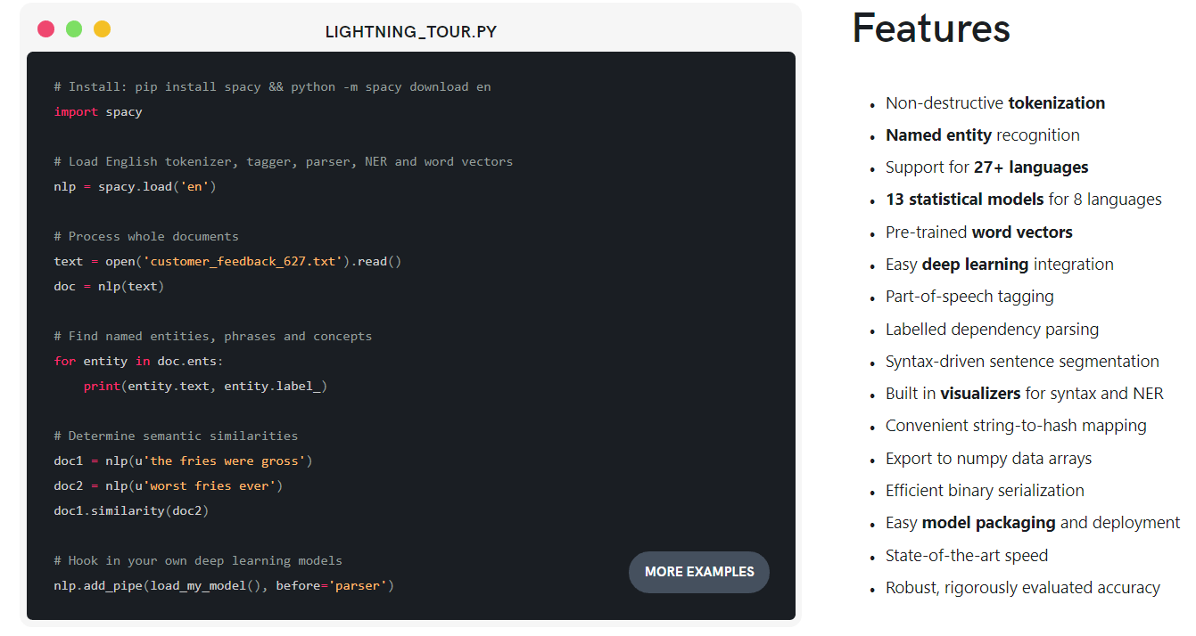
spacy

Slide 18
Spacy 2.0 Improvements
New deep learning-powered models for spaCy's tagger, parser and entity recognizer. The new models are 10× smaller, 20% more accurate require under 1 GB of memory per process.
Easier to customize the pipeline with your own components
Add text categorization models to spaCy pipelines
Improved word vectors support with the new Vectors class
Serialization API made consistent across classes and objects
Pre-trained models for 7 languages: English, French, German, Spanish, Portuguese, Italian and Dutch
Revised matcher API and phrase matcher

Slide 19
Our agenda in 5 notebooks
prologue: LANGUAGE UNDERSTANDING use cases
Introduction to spaCy
Named entity extraction & Word embeddings
ML & NLP: Building a document classifier
Introduction to Spark NLP
Embeddings, topics & model fitting with Spark NLP

Slide 20
The process of building nlp solutions
Data Preparation
Get domain-specific, representative, high-quality annotated documents
Train Language Models
Train domain-specific NLP models
Train ML / DL / IR Models
Train problem-specific classifiers, recommenders, etc.

Slide 21
ML & NLP: Common misconceptions
I can keep my NLP and ML pipelines separate
So, can I just store the NLP output, then iterate with ML?
No. Feature engineering is part of your ML pipeline
An NLP library needs its own model training code
So, should it implement its own ML algorithms?
No. The world doesn’t need another KNN / W2V / CRF
I don’t need to train, because libraries come with models
So, can I just reuse the models that came with my library?
No, in most cases. NLP is medium- & domain-specific

Slide 22
Our agenda in 5 notebooks
prologue: LANGUAGE UNDERSTANDING use cases
Introduction to spaCy
Named entity extraction & Word embeddings
ML & NLP: Building a document classifier
Introduction to Spark NLP
Embeddings, topics & model fitting with Spark NLP

Slide 23
Introducing spark nlp
Industrial Grade NLP for the Spark, Java & Scala ecosystem
Design Goals
Performance & Scale
Frictionless Reuse
Enterprise Grade
Build on top of the Spark 2.0 ML API’s
Apache 2.0 licensed, with active development & support

Slide 24
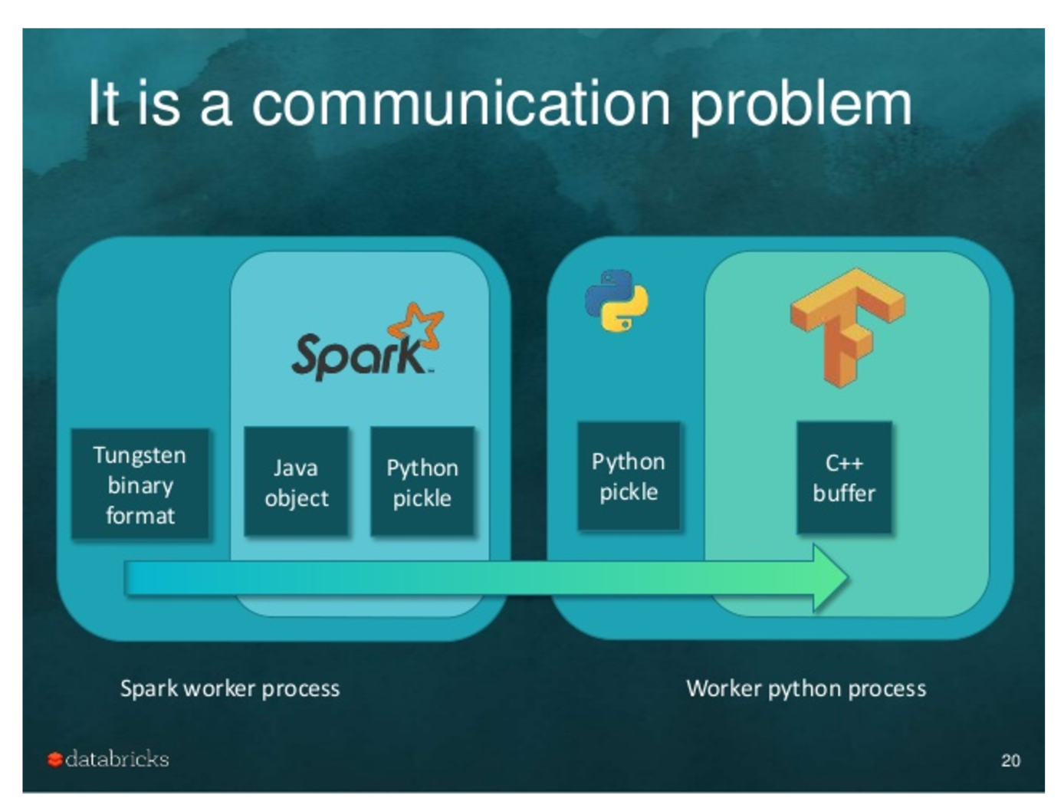
The performance bottleneck
Image Credit: Tim Hunter’s TensorFrames overview

Slide 25
Reuse: out of the box functionality
New in Spark NLP | Reused from Spark ML
Tokenizer Normalizer Stemmer Lemmatizer Entity extractor Date extractor Part of Speech tagger Named entity recognizer Sentiment analysis Assertion Status Spell checker | Topic modeling Word 2 Vec TF-IDF String distance calculation N-grams calculation Stop words removal Classification Regression Ensembles Train/Test & Cross-Validation Grid Search

Slide 26
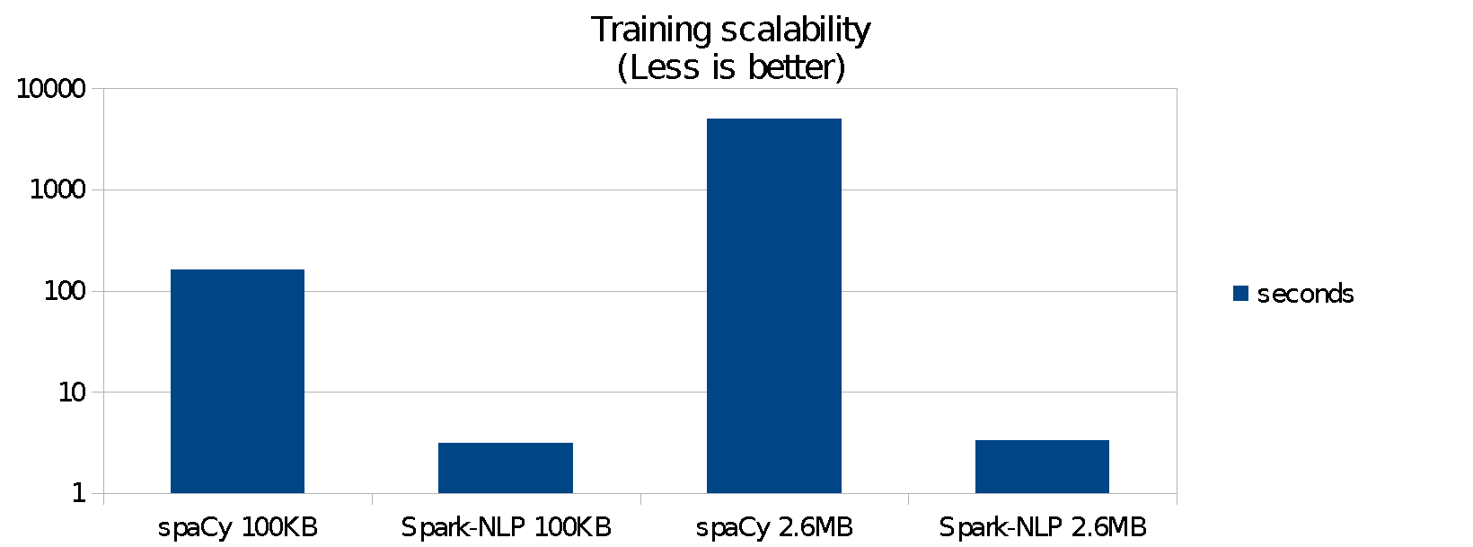
Benchmark: training
Run on a desktop PC, Linux Mint with 16GB RAM, local SSD drives, & Intel core i5-6600K processor running 4 cores at 3.5GHz
Data has been taken from the National American Corpus (http://www.anc.org), utilizing the MASC 3.0.2 written corpora from the newspaper section.
Pipeline has Sentence Boundary, Tokenization & Part of Speech
Spark-NLP was 38 times faster to train on 100kb of data
Spark-NLP was 80 times faster to train on 2.6mb of data

Slide 27
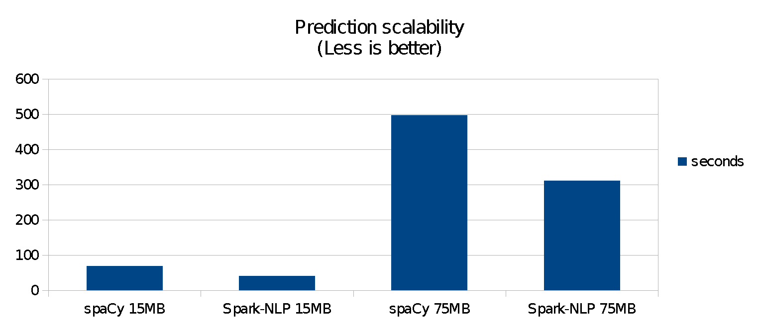
Benchmark: PREDICTION
spaCy was faster on a 140kb dataset (both libraries finished in under a second)
Spark-NLP was 1.4 times faster on a 15mb dataset (about 40 vs. 70 seconds)
Spark-NLP was 1.6 times faster on a 75mb dataset (about 5 vs. 9 minutes)
Both libraries were configured to leverage all CPU cores

Slide 28
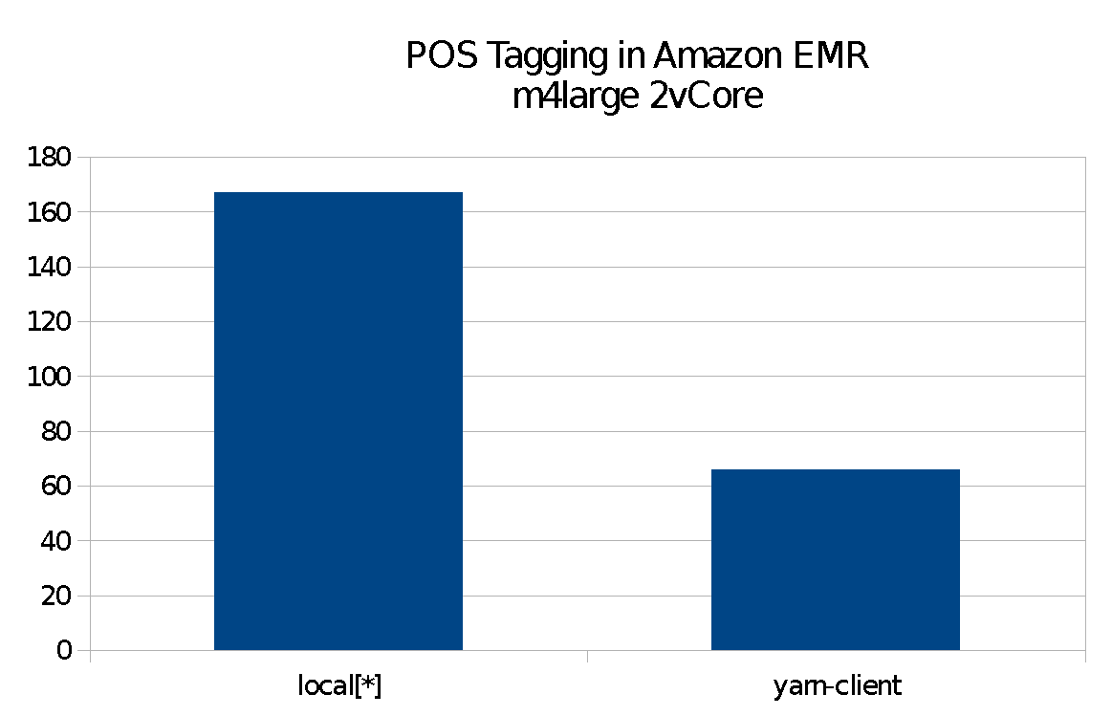
Benchmark: SCALING
Spark-NLP against itself
2.5x speedup with a 4-node cluster
Zero code changes
Spark scales as Spark does: 1 to 3 orders of magnitude faster depending on cluster setup
Not compares to spaCy, since it cannot leverage a cluster

Slide 29
THANK you!
Claudiu Branzan Alex Thomas David Talby

